Slide 1
Models of the motor system
Spring 2025
Opher Donchin

Slide 2
Part 1
Manifolds

Slide 3
A revolution in motor cortex
From neurons to population coding
From population coding to manifolds

Slide 4
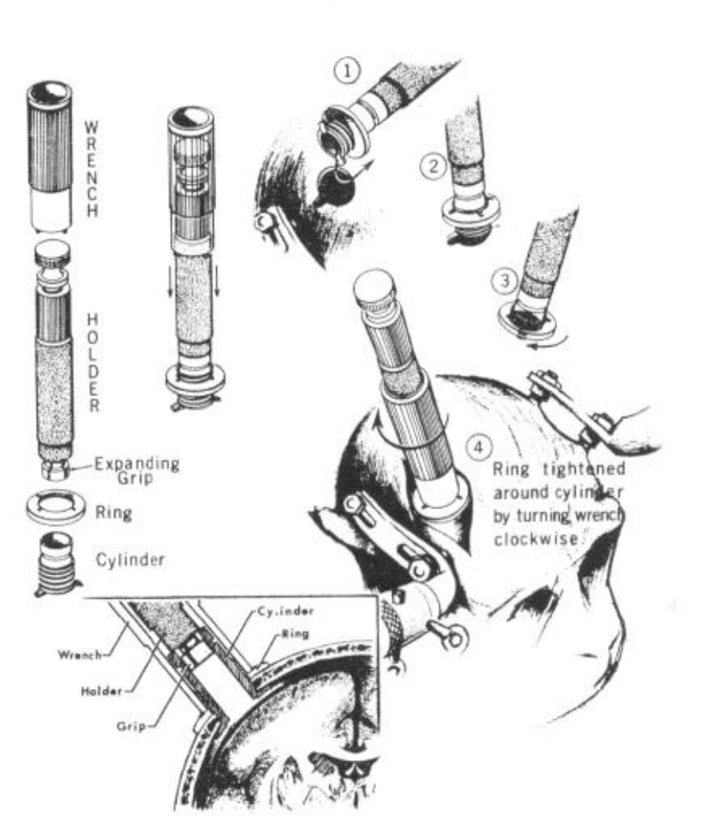
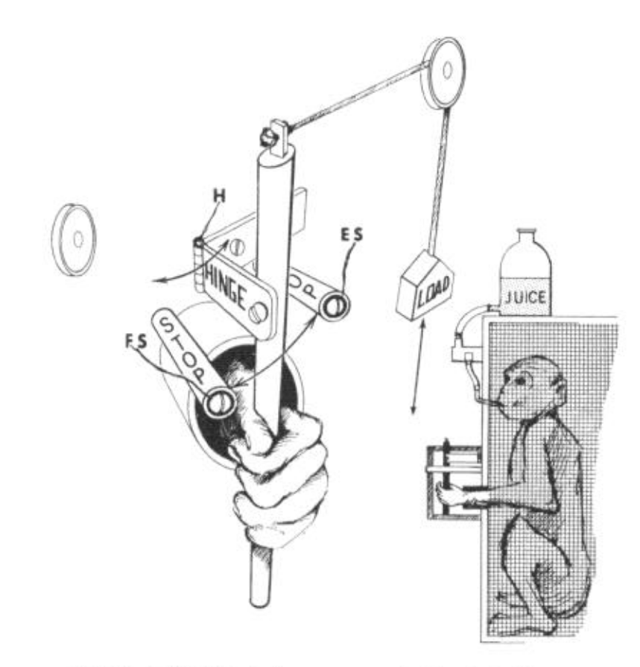
Before Georgopoulos
Simple one joint movements
Neural recording from a single neuron
Evarts J Neurophysiol 1968

Slide 5
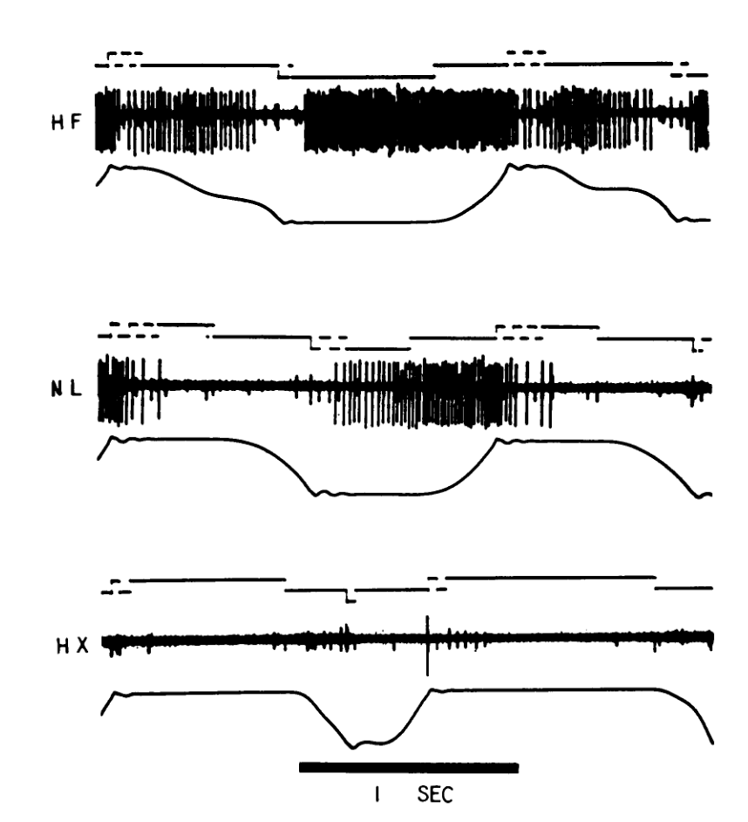
Before Georgopoulos
Increased force leads to increased activty
Evarts J Neurophysiol 1968

Slide 6
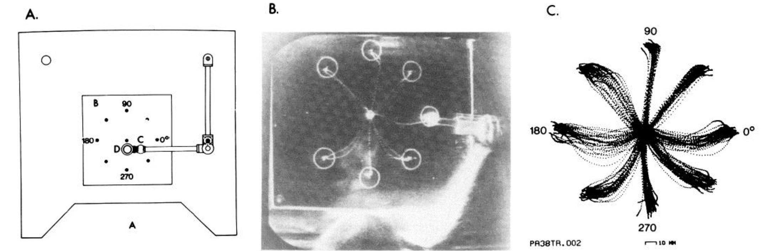
Georgopoulos
Free movements in two and three dimensional space
Georgopoulos J Neurosci 1982

Slide 7
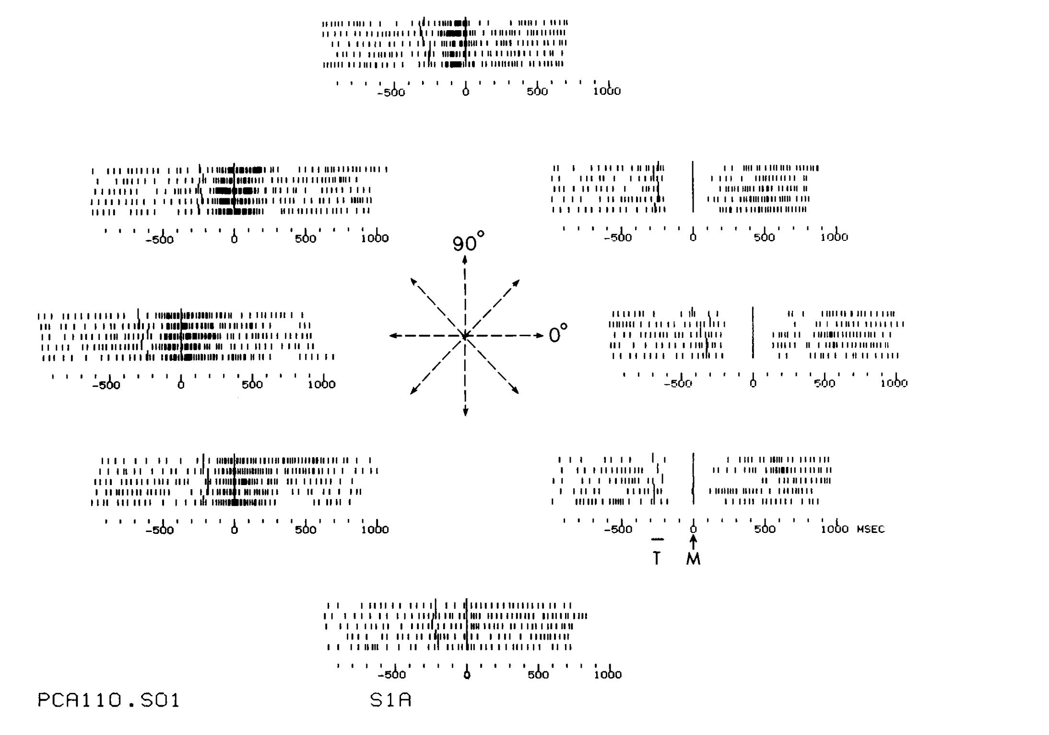
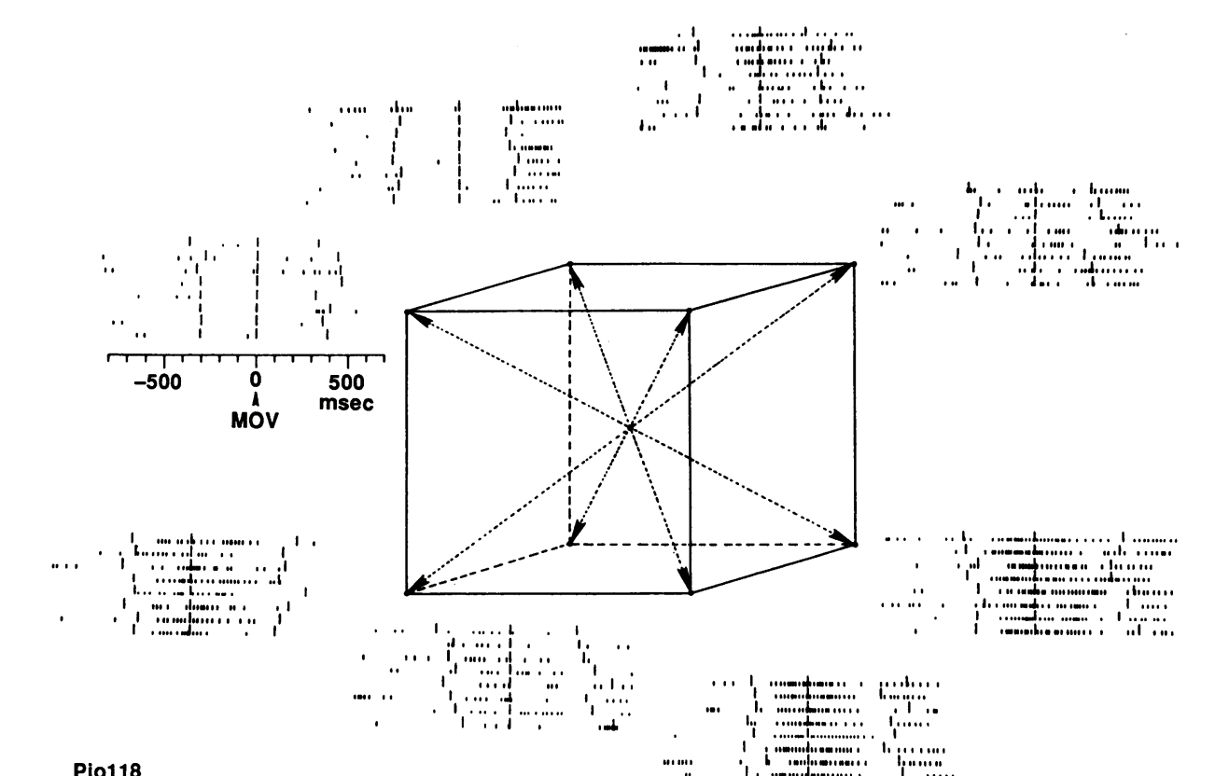
Georgopoulos
Tuning of individual neurons for specific directions
Georgopoulos J Neurosci 1982

Slide 8
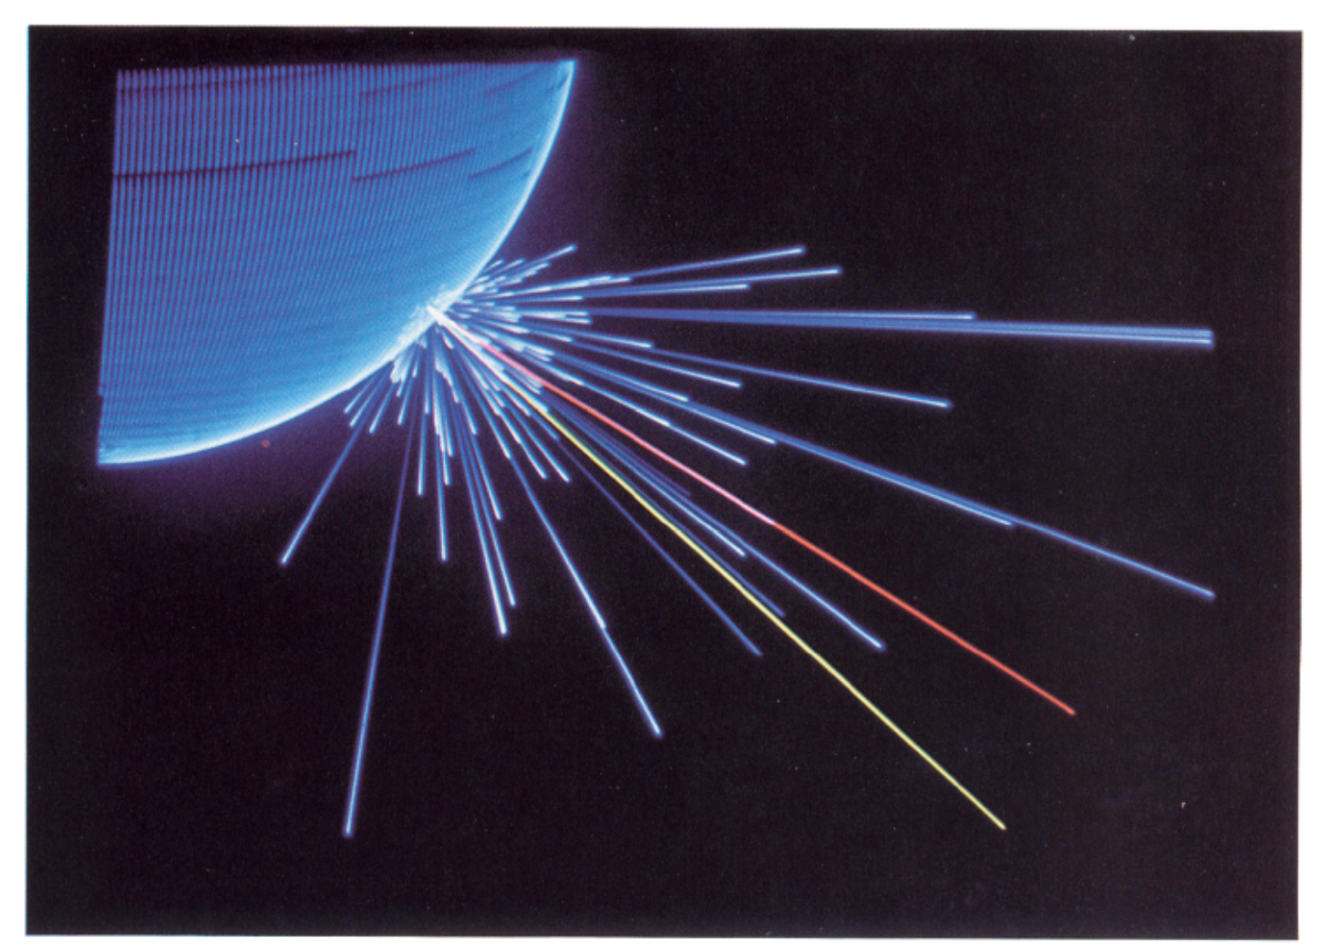
Georgopoulos
Population vectors
Georgopoulos Science 1986

Slide 9
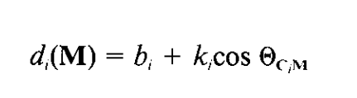
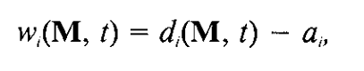
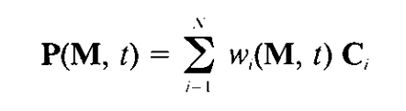
Georgopoulos
Population vectors
Individual neuron tuning
Linear combination of activation functions
Georgopoulos Science 1986

Slide 10
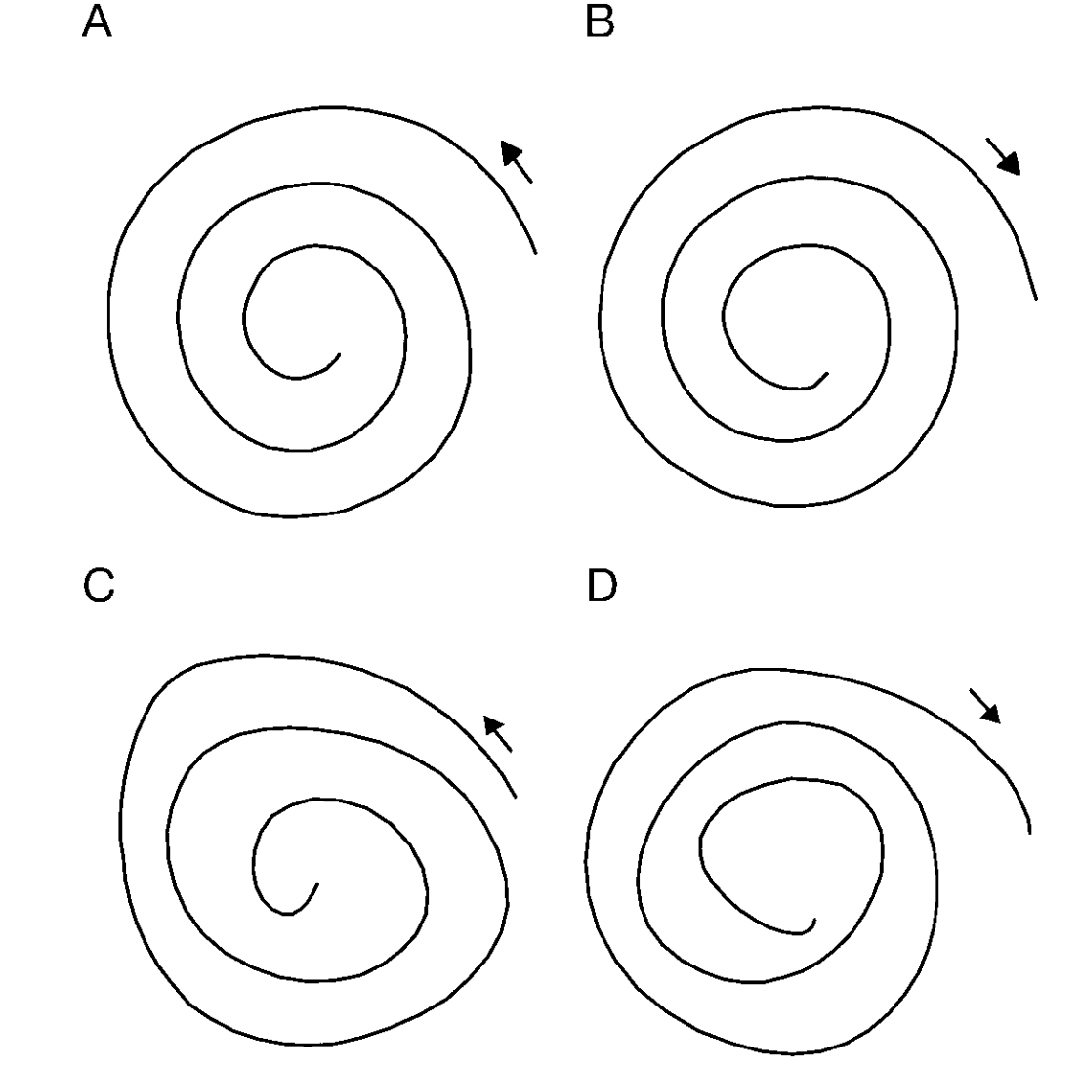
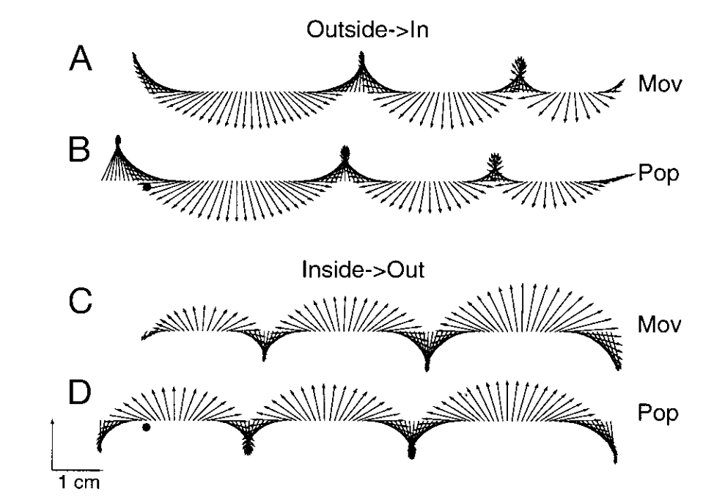
Population vector for BCI
Moran J Neurophysiol 1999

Slide 11
Video of current BCI

Slide 12
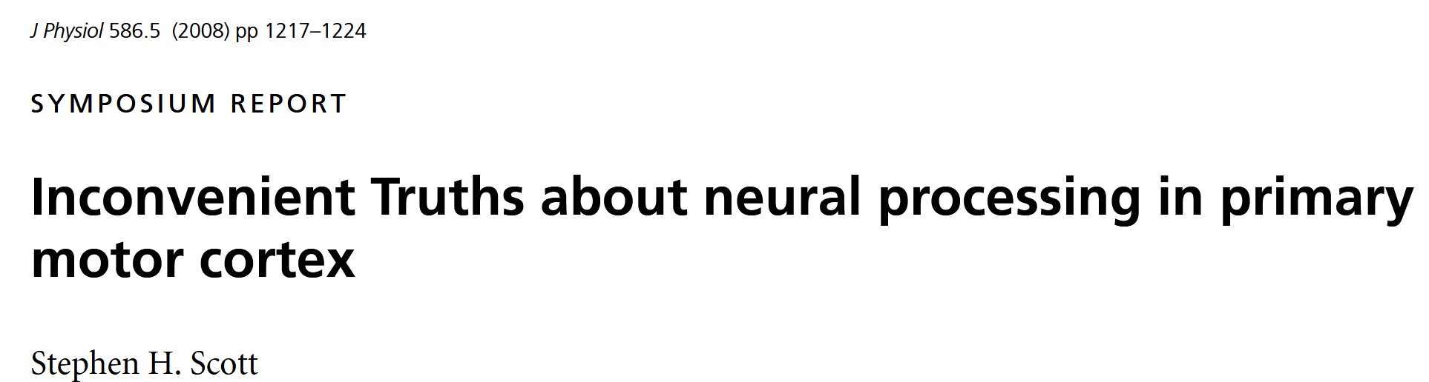
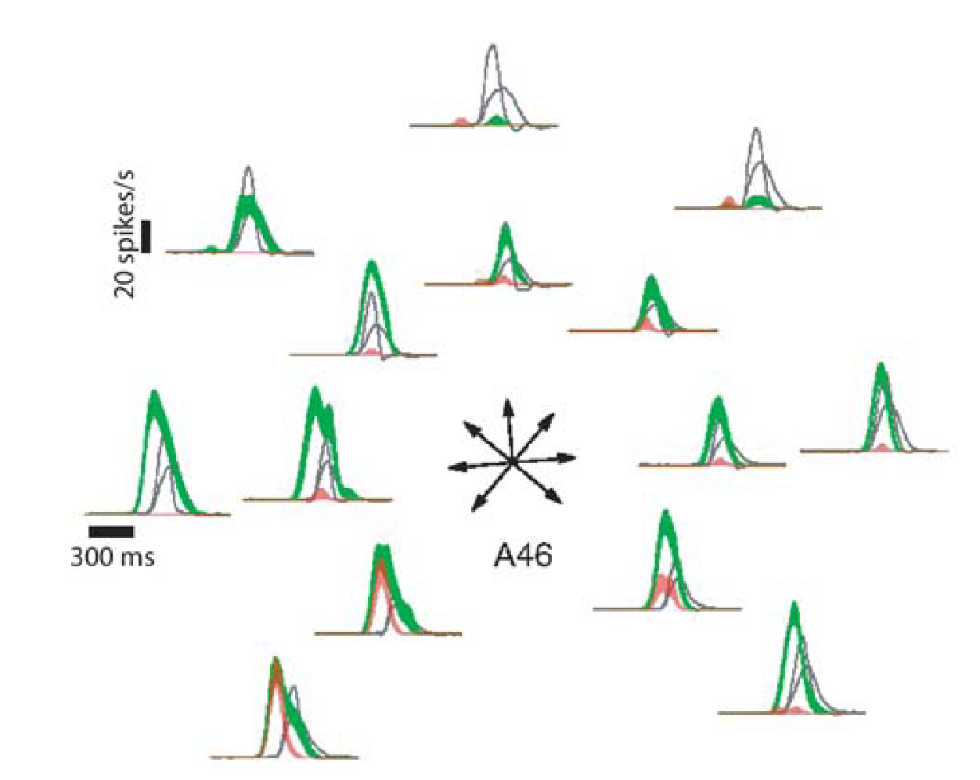
Nails in the population vector coffin
Coding is hard to disentangle

Slide 13
Part 2
Rotational dynamics in M1

Slide 14
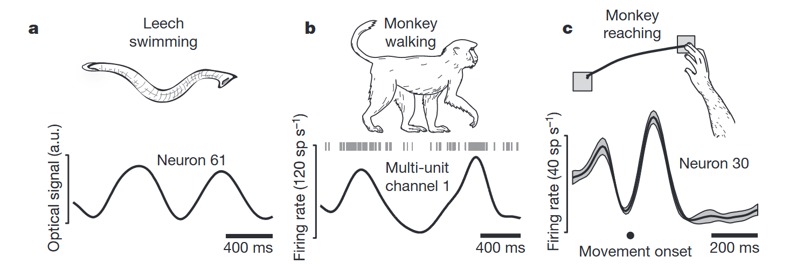
Oscillations in movement and neural activity
Neural oscillations are not only in rhythmic movements
Churchland Nature 2012

Slide 15
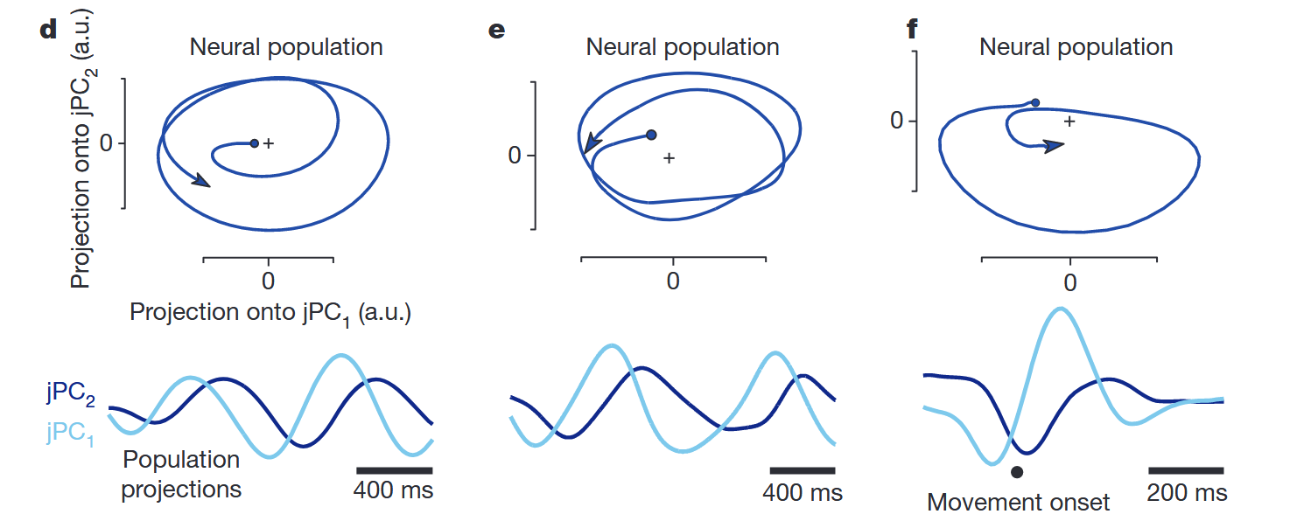
Rotational dynamics
Oscillatory activity leads to rotational dynamics
Churchland Nature 2012

Slide 16
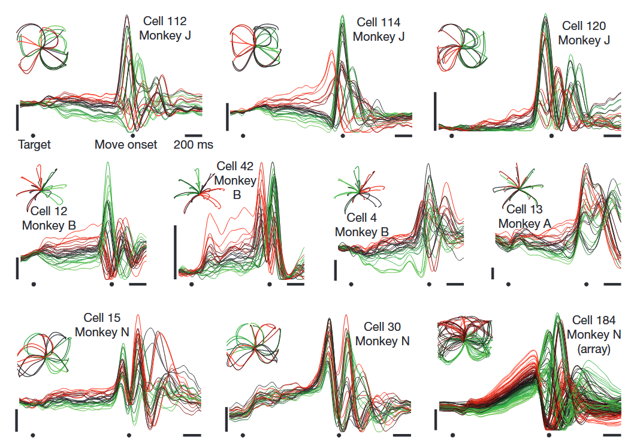
Oscillations predicted by preparatory activity
Churchland Nature 2012

Slide 17
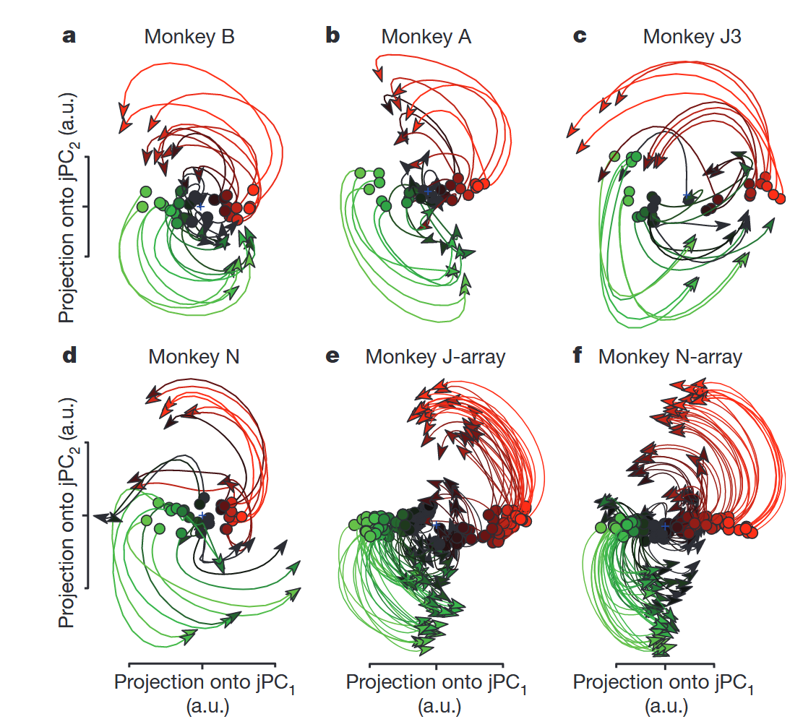
Population wise: pre-movement initial condition predicts rotational dynamics
Churchland Nature 2012

Slide 18
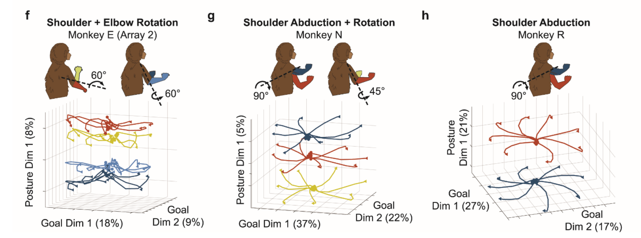
Null spaces for multiplexed computations
Marino bioRxiv 2024

Slide 19
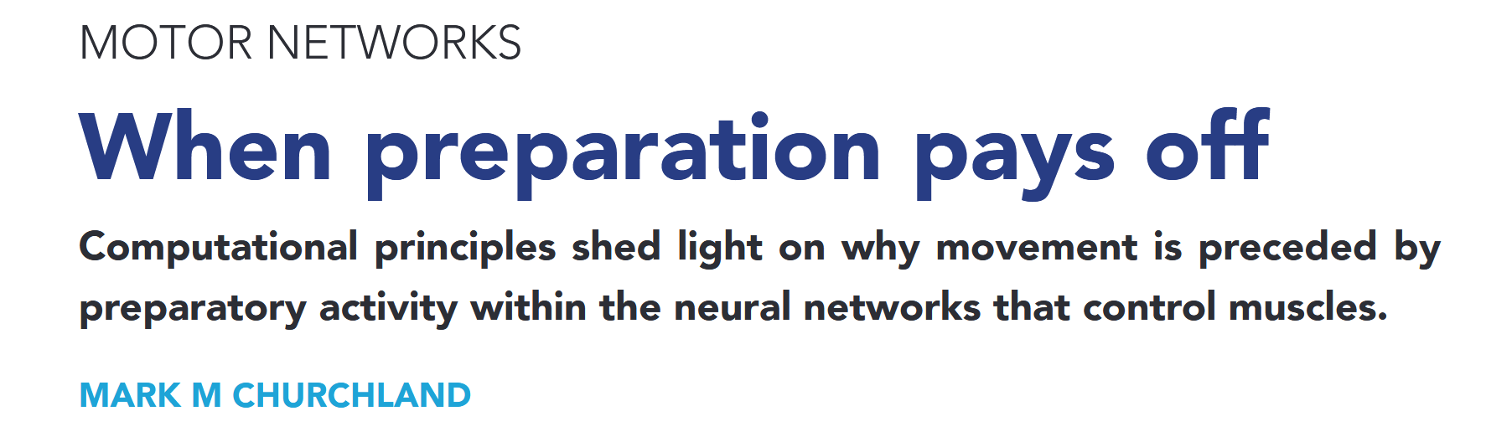
Null space is where it’s at

Slide 20
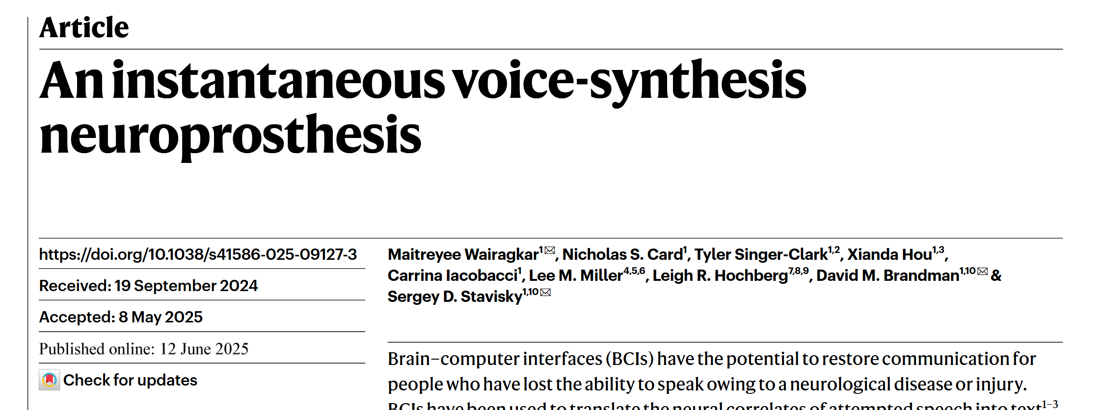
Manifolds and BCIs

